Slide 1
Functions
Intro to Programming in Python

Slide 2
Today’s material
Quickly learn functions (easy)
Learn ASCII character values (easy)
Define our encryption program
Create an algorithm for our encryption program
Code our encryption program using EVERYTHING

Slide 3
Functions
A function is a type of procedure or routine.
You have already used multiple functions that are built in to the Python language in previous meetings, can you name some?

Slide 4
Remove Vowels
Let’s write a quick program that uses a function to remove vowels from any string we pass to it.
We have already written the code for vowel removal from a string previously, now we just need to put it in a function
Create a new python file called Remove Vowels

Slide 5
Remove Vowels
You can create the function first, or the other code that calls the function. Today we will create the other code first.
ALGORITHM:
get user input of some string
call our function on that string
print out the old string and the new string

Slide 6
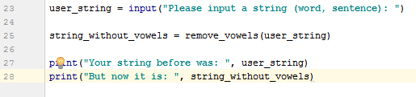
Remove Vowels
get the user input, store it in a variable (we all know how to do this)
call our function (named remove_vowels) on the user’s string. This means we will call our function, give it the user’s string, and it will return a new string with all vowels taken out.
print out the old string and the new string

Slide 7
Remove Vowels
Now we must write the remove_vowels(…) function.
Start with the function signature:
def is a keyword in python (think ‘defining’) remove_vowels is what our function is called, and my_string is the name of the parameter we will pass to our function.
Now we just need to define the body of our function, which describes what the function will actually do.
The function will take in a user string (my_string) and remove the vowels, then return the new string.

Slide 8
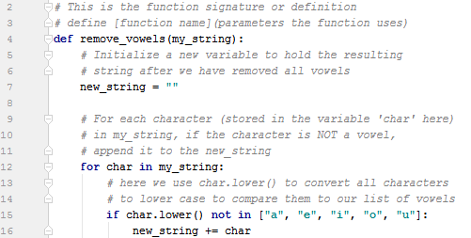
Remove Vowels
Last time we met we wrote a remove vowels program using a for loop. Here we will use that same program, but I will just write it for you to speed things up.
Our function now looks like this:

Slide 9
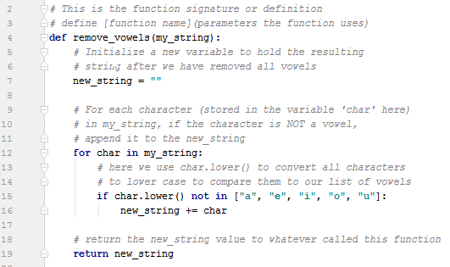
Remove Vowels
Almost everything is done, now we only need to return the value of our new string so that whatever invoked the function can store or use it’s result.
you can do this using the keyword return, which will return whatever you put after it (if its valid)
Now our completed remove_value function looks like this:

Slide 10
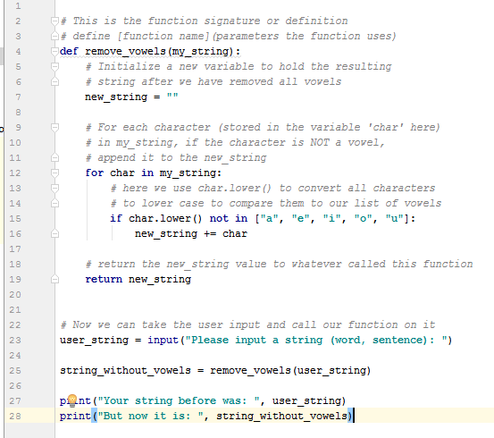
Remove Vowels
Our final program looks like this:
NOTE, the function MUST be defined before it can be used! If your function definition is below what uses it, it won’t work! The computer does not know what it is yet!
Run the Remove Vowels.py file and test it out

Slide 11
ASCII Values
ASCII stands for American Standard Code for Information Interchange
ASCII values are how a computer tells what an ‘a’ or a ‘b’ or a ‘c’ or a ‘1’ are. (Computers only truly know charged or not charged)
When you type ‘Dane’ into a word doc, the computer associates each character with a numerical value in an ASCII table. ‘Dane’ in ASCII is: 68 97 110 101
The computer really stores these numbers as 0’s and 1’s in binary representing these values, but that’s a different subject and you don’t need to understand it now.

Slide 12
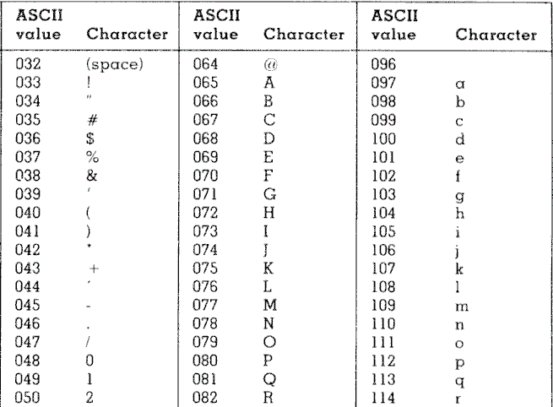
ASCII Values Chart
Here is a chart of characters and their associated ASCII values

Slide 13
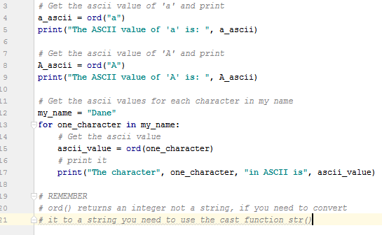
Getting ASCII values in python
Python has another built in function to get the ASCII value of an alphanumeric character (a-z, A-Z, 0-9, symbols)
the ord() function will take in a character and return its asci value as an integer.
Here is a simple example:

Slide 14
Secret Message
Our program will take a message, and convert each character to its corresponding ASCII value to ‘encrypt’ it.
Our program will also take a message in ASCII value and convert each value to its corresponding character to ‘decrypt’ it.
we will need TWO functions, one for encryption and one for decryption.

Slide 15
Secret Message
Write a program that will take as input a message from the user, as well as a ‘1’ for encryption, and a ‘2’ for decryption, and based off the second input will encrypt or decrypt the user’s message and print it out.
ALGORITHM:
Get message as input from user
get 1 (encrypt) or 2 (decrypt) as input from user
if the user selected 1, encrypt the message
else if the user selected 2, decrypt the message
else, make the message an error message
print out the resulting message

Slide 16
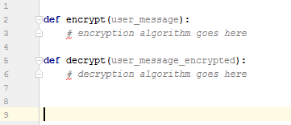
Secret Message
Lets write everything for our program except for the functions. For now, we will just declare the functions and leave the bodies empty at the top of our program.
Create a new python file called ‘Secret Message’
Add the function definitions for encrypt and decrypt

Slide 17
Secret Message
Now lets follow our original algorithm to write the basic steps of the program
ALGORITHM:
Get message as input from user
get 1 (encrypt) or 2 (decrypt) as input from user
if the user selected 1, encrypt the message
else if the user selected 2, decrypt the message
else, make the message an error
print out the resulting message

Slide 18

Secret Message
Get message as input from user, store in a variable.
Get option (1 or 2) as input from user, store in variable

Slide 19
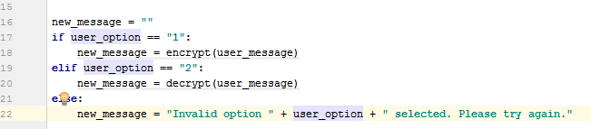

Secret Message
done
done
if the user selected 1, encrypt the message
else if the user selected 2, decrypt the message
otherwise, print error
print the resulting message

Slide 20
Secret Message
Now we need to write out a simple algorithm for our encrypt function. Help me out on the whiteboard!
How to design an algorithm for beginners:
what does our algorithm need to accomplish
what needs to be done first?
what needs to be done second?
what needs to be done after the first and second thing?
what will we do at the end?

Slide 21
Secret Message
Now we need to write out a simple algorithm for our decrypt function. Help me out on the whiteboard!
How to design an algorithm for beginners:
what does our algorithm need to accomplish
what needs to be done first?
what needs to be done second?
what needs to be done after the first and second thing?
what will we do at the end?

Slide 22
Secret Message
Encryption Algorithm for encrypt
initialize a new variable to hold our encrypted message
for each character in the user’s message, find the ASCII value
append this ASCII value to our encrypted message variable
return the newly encrypted message

Slide 23
Secret Message
Decryption Algorithm for decrypt
initialize a new variable to hold our decrypted message
initialize an variable ‘str_index’ and set it to 0 (used to loop through each character in the string of ASCII values)
while x is less than the length of the user’s message
get the current character in the user’s message at index str_index
if the current character is a 1, we know that the ASCII value will be three digits, get the next two digits and find their corresponding character value of the current digit concatenated with them
else we know that the ASCII value will be two digits, find the corresponding character value of the current digit concatenated with the next
increment x by the number of ASCII characters we consumed to find the corresponding character value
append the decrypted character (the character representation of the found ASCII value) to our decrypted_message variable
return our decrypted message variable

Slide 24
Code Along

